Slide 1
ADC & DAC
The analog signals produced by various sensors and transducers have one characteristics called Bandwidth.
The analog signal can be converted into digital format in two stages:
Sampling
Quantization

Slide 2
Sampling
Sampling converts a time-varying signal into a discrete-time signal, a sequence of real numbers.
To obtain signal values from the continuous signal at regular time-intervals.
The analog signal is sampled every T_{s} s, where T_{s} is the sample interval or period.
The inverse of the sampling interval is called the sampling rate or sampling frequency and denoted by f_{s} where f_{s}=1/ T_{s}.

Slide 3
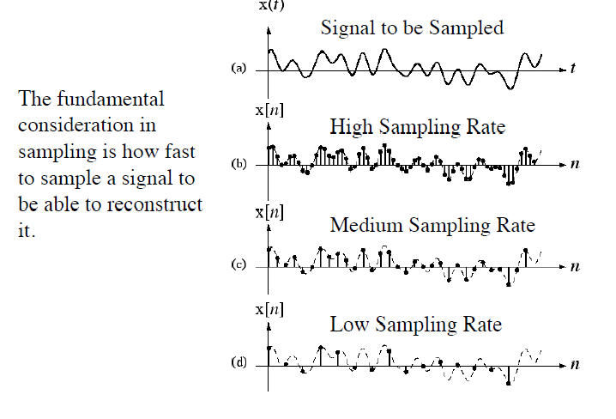
Sampling

Slide 4
Nyquist Theorem
How many samples are needed to correctly represent an analog signal ?
According to the Nyquist theorem, the sampling rate must be at least 2 times the highest frequency contained in the signal.
If the bandwidth of a signal is B Hz, the number of samples required per second(called the sampling rate) should be at least 2B. So, for the voice signals with a bandwidth of 4 kHz, the minimum sampling rate is 8000 samples per second.

Slide 5
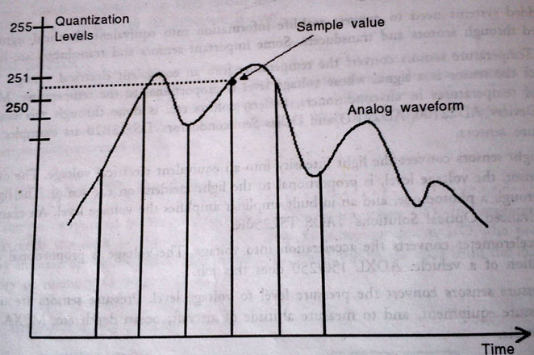
In quantization, the sampled value is converted into a number,

Slide 6
Quantization
After the sampling we have a sequence of numbers which can theoretically take on any value (In y-axis).
In order to be able to represent each number from such a range, we would need an infinite number of digits .
We must represent the numbers with a finite number of digits, so now we need to convert these discrete numbers into digital numbers.
Quantization replaces each real number with an approximation from a finite set of discrete values.

Slide 7
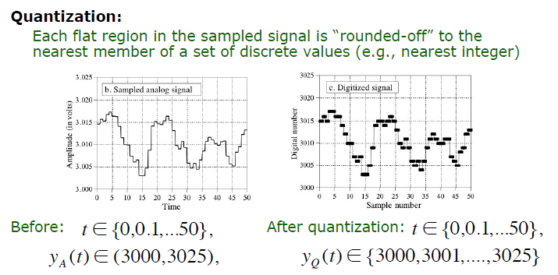
Quantization

Slide 8
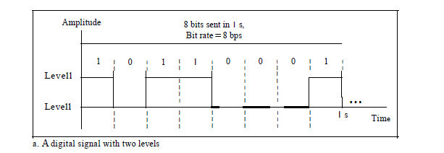
A digital signal can have more than two levels.
2

Slide 9
A digital signal can have more than two levels.
2

Slide 10
Resolution =3 bits.

Slide 11
Example

Slide 12
Analog-to-digital conversion introduces error because each sample value is rounded off to its nearest quantization level. This error is known as quantization error.

Slide 13
ADC

Slide 14
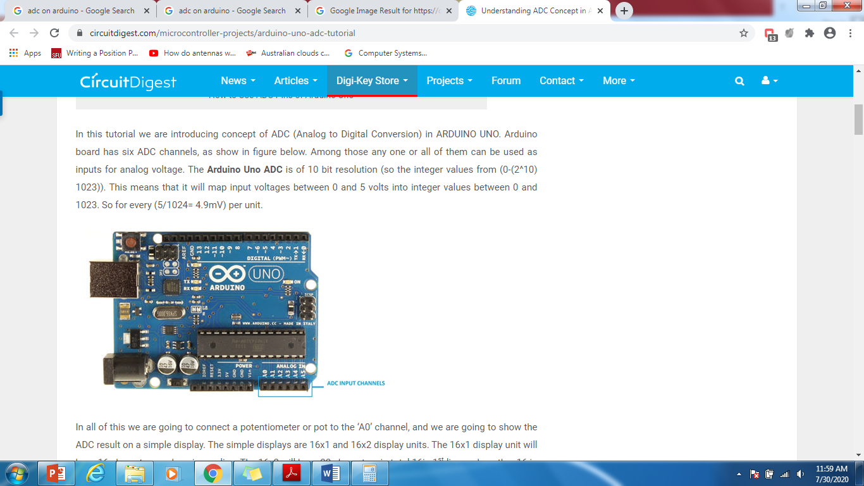
Example in Arduino

Slide 15
Example in Arduino
Arduino board has six ADC channels, as show in figure below. Among those any one or all of them can be used as inputs for analog voltage.
The Arduino Uno ADC is of 10 bit resolution (so the integer values from (0-(2^10) 1023)).
This means that it will map input voltages between 0 and 5 volts into integer values between 0 and 1023.
So for every (5/1024= 4.9mV) per unit.

Slide 16
Sensors and Transducers
Embedded Systems need to convert real-life information into equivalent electrical signals.
This is achieved through sensors and transducers.
What ever we sense, everything are analog signals. Their amplitude varies continuously with time.
So we must use ADC chips to convert it into digital signals

Slide 17
Sensors and Transducers

Slide 18
Sensors and Transducers

Slide 19
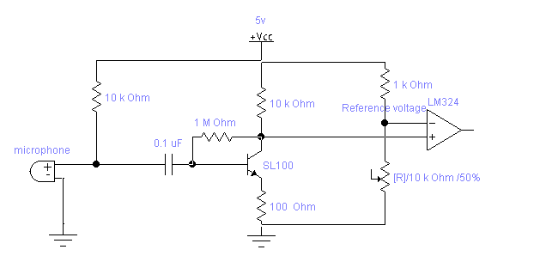
Example
Microcontroller

Slide 20
Example
Figure shows the Sound Sensor circuit diagram of the project .It contains Microphone which is used to convert acoustic energy into electrical energy. The condenser microphone is used as transducer in this circuit diagram.
The electrical signal coming from microphone is too low. So, we need to amplify our electrical signal coming from MIC. Transistor (SL 100) is used to amplify that signal. Resistances are used for amplification adjustment. Capacitor is used to decouple microphone from transistor.
Sound sensor is designed to give it the ability to respond to sounds ,claps, whistles ,etc. Output of the sound sensor is given to LM324 Comparator.
At last, comparator (LM324) compares the signal with reference voltage. If the signal coming from microphone is greater than the threshold voltage, then it sends logic 1 otherwise 0.
This is the general working principle of this Sound sensor.

Slide 21
Chip Select
If there is need to connect several devices to the same set of input wires (i.e., a computer bus), but retain the ability to send data or commands to each device independently of the others on the bus, they can use a chip select.
The chip select is a command pin on most ICs which connects the input pins on the device to the internal circuitry of that device.

Slide 22
Serial Peripheral Interface(SPI)
Developed by Motorolla, It is used for short distance communication between different peripherals.
Peripheral Devices such as memory chips, ADC/DAC, etc are provided with SPI interface so that they can be interface with the processor
SPI is a synchronous data transmission protocol. In synchronous data transmission, the sender and receiver share a clock with one another.
This interface is widely used in embedded system.

Slide 23
Serial Peripheral Interface(SPI)
SPI devices communicate in full duplex mode using a master-slave architecture with a single master.
The master device originates the frame for reading and writing.
Multiple slave-devices are supported through selection with individual slave select (SS), sometimes called chip select (CS), lines.
SPI Signals(Uses 4 types of signals for interfacing peripherals to processor)
1. Master Out Slave In (MOSI)
Master sends byte to slave, and slave reads
2. Master In Slave Out (MISO)
Slave sends it’s register content, master reads
3.Serials Clock (SCLK)
O/p from Master(generates the clock & synchronize peripherals)
4. Chip Select (CS)
O/p from Master

Slide 24
Serial Peripheral Interface(SPI)
In SPI interface, devices works in Master/Slave mode.
MOSI
MOSI
Master
MISO
MISO
Slave
SCLK
SCLK
CS
CS
Processor
Peripherals

Slide 25
Serial Peripheral Interface(SPI)
SPI can be configured in 2 ways
Independent Slave Configurations
Daisy chain configuration

Slide 26
Independent Slave Configurations
In the independent slave configuration, there is an independent chip select line for each slave.
The master asserts only one chip select at a time.
The MISO line, MOSI lines and clock lines of all the devices are connected together.
But the chip select pin of each peripheral is connected to separate slave select pins of the master.

Slide 27
Independent Slave Configurations
In the independent slave configuration, there is an independent chip select line for each slave.
The master asserts only one chip select at a time.
The MISO line, MOSI lines and clock lines of all the devices are connected together.
But the chip select pin of each peripheral is connected to separate slave select pins of the master.

Slide 28
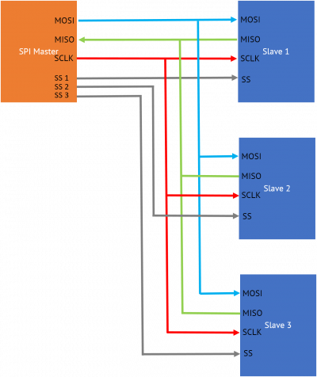
Independent Slave Configurations

Slide 29
Daisy Chain Configuration
In cascaded or daisy chain configuration, the clock lines and chip select lines of all devices are connected together.
The data from the master flows through each peripheral and returns to the master.
Used while relaying information in each devices.
The data output of the preceding slave device is attached to the data in of the next device. Only a single SS line is required by the master.

Slide 30
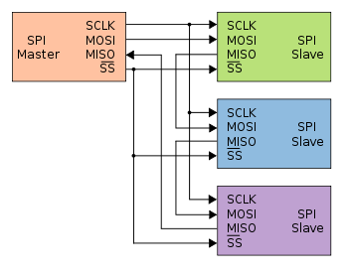
Daisy Chain Configurations

Slide 31
SPI Interface
SPI is a widely used protocol, so it is included in most of the microcontroller families.
Some of the chips using SPI are listed below.
Flash memories and EEPROMs, e.g: Microchip SST25VF080
SD/MMC Cards
Real Time Clock chips, e.g: Maxim DS1347
Analog to Digital converters, e.g: Microchip MCP3008
Battery management ICs, e.g: TI BQ76PL536
TFT LCD display drivers, e.g: ILI9341

Slide 32
SPI Interface
Advantages of SPI
Supports multiple slave devices
Full duplex communication, transfer data in and out at the same time.
Significantly high data rates (in megabits/second) as compared to other serial communication stands, sometimes in megahertz range.
Simple protocol and easy to implement for single-master single-slave applications
Less complex circuitry and there is no need of external transceivers, so it is a very easy interfacing.
Disadvantages of SPI
Required number of pins are high as compared to other serial protocols
Absence of in-chip addressing, it needs separate chip select of each devices

Slide 33
Inter Integrated Cicuit(I² C)
It also use Master Slave Protocol.
Serial Clock (SCLK)
Serial Data(SDA)
Device
Device
Device

Slide 34
Inter Integrated Cicuit(I² C)
It uses 2 lines(bidirectional) for connecting devices.
SDA (Serial Data) – The line for the master and slave to send and receive data
SCL (Serial Clock) – The line that carries the clock signal.
It is a multi-master bus, more than one device can act as master.
Same line is used for master transmission and slave response.
It is a Half Duplex Communication

Slide 35
Inter Integrated Cicuit(I² C)
I2C is also serial communication protocol, so data is transferred bit by bit along a single wire (the SDA line).
Like SPI, I2C is synchronous, so the output of bits is synchronized to the sampling of bits by a clock signal shared between the master and the slave. The clock signal is always controlled by the master.

Slide 36
Debug Port
Debugging port is used to find bugs or defects in any electronic hardware.
Joint Test Access Group standardized the mechanism for providing debugging through a port called JTAG port.
JTAG port can also be used to download software onto the embedded system.

Slide 37
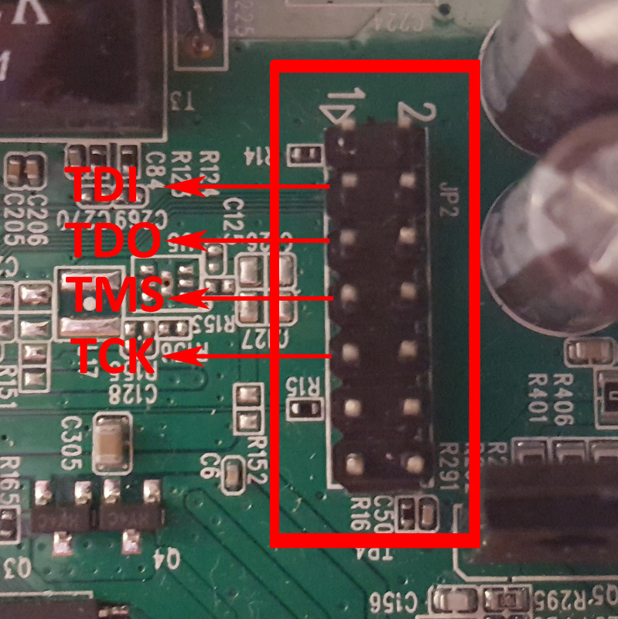
Debug Port
JTAG port consists of 4 signals
Test Data Input (TDI)
Test Data Output (TDO)
Test Mode Select (TMS)
Test Clock (TCK)
JTAG port is like a synchronous serial interface. JTAG port can also be used to download the software onto the embedded system.

Slide 38
Power Supply Unit
The components in Embedded System uses DC voltage.(Ranging from +12 volt to -12 volt).
So, DC to DC converter are widely used in embedded system. The 2 types of DC- DC converters are
Linear Regulator
Output Voltage is less than Input Voltage.
Less efficient and wastes more power.
Switching Regulator
Step Up/ Step Down the input voltage.
More efficient and waste less power during conversion.

Slide 39
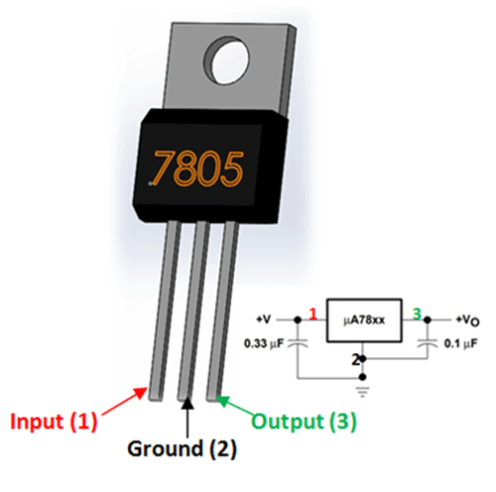
Power Supply Unit
Voltage regulators are very common in electronic circuits. They provide a constant output voltage for a varied input voltage. In 7805 IC it provides 5V as output.

